Slide 1
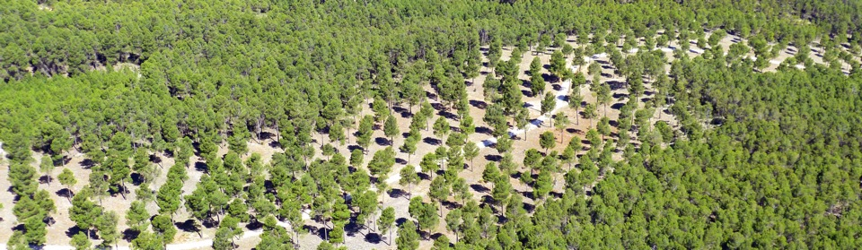



LULUCF: practical consequences for the Forest-based sector.
Multiple benefits of climate action at the local level: LIFE FOREST CO2

Slide 2



LIFE FOREST CO2
1.Introduction
1.
INTRODUCTION

Slide 3
LIFE FOREST CO2
1.Introduction
Setting the scene
During 2014, due to a series of constraints, the efforts on climate change mitigation in the European Union didn´t take all its potential.
The sector of Land Use, Land Use-Change and Forestry (LULUCF), is not taken into account in the EU Climate Emission Reduction targets (40% by 2030). This leaves a sector with a high mitigation potential such as forest management out of the struggle against climate change, sector of special interest for its contribution to forest conservation and its numerous ecosystem services.
Economy sectors not regulated by the Emissions Trading Scheme (EU ETS), Diffuse sectors, account 60% of GHG emissions but they are not obligated to be involve in ETS.

Slide 4










PROYECTO LIFE FOREST CO2
1.Introduction
Carbon sink increase up to 170 Mt Co₂/year for 2050 through sustainable forest manegement
SUSTAINABLE FOREST MANEGEMENT
Foresting abandoned farmlands up to 70 Mt Co₂/year for 2030
FOREST MANAGEMENT
SECTOR
FORESTING
Domestic use of biomass/Forestry wastes/ could cover over 4% of energetic demand
(180 Mt Co₂/year)
Carbon sink increasing possibility of 400 Mt Co₂/year for 2030 in European Union.
USE OF BIOMASS
LIFE14 CCM/ES/001271 – LIFE FOREST CO2

Slide 5
LIFE FOREST CO2
1.Introduction
Setting the scene
On the other hand, the first steps to encourage actions on forest carbon sinks, both in Europe and in Spain are already taken:
EUROPE
SPAIN
Implementation of Carbon Footprint Registry, Compensation and Absorption Projects by the Ministry of Agriculture and Fisheries, Food and Environment, March 2014.
Decision 529/2013/EU on accounting rules on greenhouse gas emissions and removals resulting from activities related to LULUCF and on information concerning actions relating to those activities was published in 2013.
It excludes Forestry Management from the project section due to the complexity of calculations, amongst other reasons.

Slide 6

LIFE FOREST CO2
1.Introduction
PROJECT FRAMEWORK
Need to promote sustainable forest management as a carbon sink
Need to involve diffuse sectors in order to reduce emissions
LIFE FOREST CO2 PROJECT
Opportunity to define carbon sink effect of forest management in non-productive forests through D. 529/2013
Opportunity to promote the conservation of forests and their ecosystem services

Slide 7
LIFE FOREST CO2
1.Introduction
Objectives LIFE FOREST CO2
MAIN OBJECTIVE:promotion of forest systems and sustainable forest management as a tool for climate change mitigation, through the application of European regulations on emissions accountings and removals in the LULUCF sector, improving knowledge at local level and making an integrated and practical application, covering all involved sectors and including diffuse sectors.
Defining, according to Decision 529/2013/EU and the IPCC, the accounting models for net anthropogenic CO2 removals as a consequence of sustainable forest management in forestlands of P. halepensis and P. pinaster
Involve the forest-based sector in the development of forestry projects about carbon storage and sustainable forest management
Encourage a change in business culture within companies and institutional sector which will enable to move towards a low carbon economy
Modeling and summarising the information related to carbon removals, and transferring it to relevant agents so that it can be considered in the accounting of carbon sinks in LULUCF sector
Promote Project in diffuse sectors in the Forest-based sector as a tool for mitigating climate change through the voluntary compensation of CO2 emissions

Slide 8

LIFE FOREST CO2
2.Actions
2.
ACTIONS

Slide 9
LIFE FOREST CO2
2.Actions
Guidelines
CHARACTERISA-TION OF CARBON SINKS IN MANAGED FOREST MASSES
INVOLVEMENT OF FOREST OWNERS AND DIFFUSE SECTORS IN CLIMATE CHANGE MITIGATION
REPLICATION OF PROJECT ACTIONS
DISSEMINATION OF RESULTS AND AWARENESS RAISING

Slide 10
LIFE FOREST CO2
2.Actions
Characterisation of carbon sinks on managed forests of P. halepensis and P. pinaster: metodology
Organic carbon sink in soils
Carbon sink in fallen leaves and dead organic materials in soils
Carbon sink in aerial and root biomass
Modeling of carbon storage as a consequence of forest management in forest masses

Slide 11
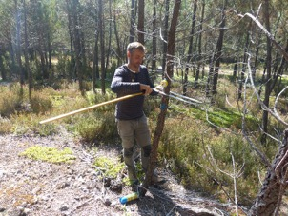
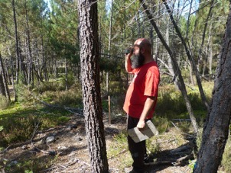
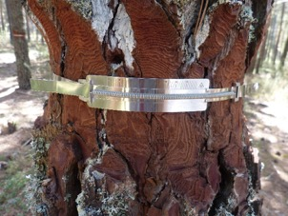
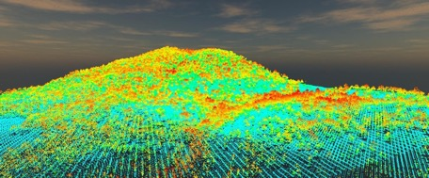
LIFE FOREST CO2 PROJECT
2.Actions
Carbon sink modeling in aerial and root biomass

Slide 12
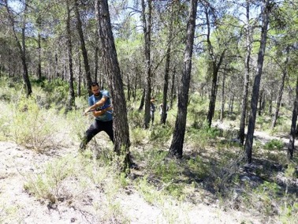
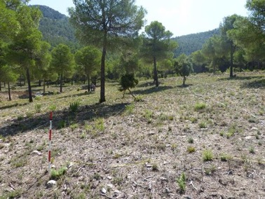
LIFE FOREST CO2 PROJECT
2.Actions
Organic carbon sink in soils modeling.
Selected areas including not managed masses and managed masses. More than 1.500 samples analyzed.
Not managed
Managed

Slide 13
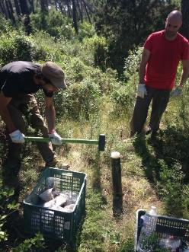
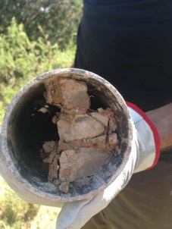
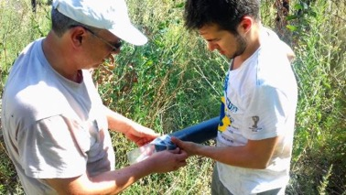
LIFE FOREST CO2 PROJECT
2.Actions
Organic carbon sink in soils modeling

Slide 14
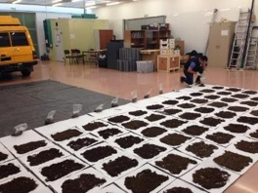
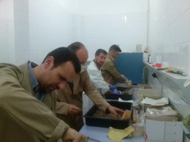
LIFE FOREST CO2 PROJECT
2.Actions
Organic carbon sink in soils modeling
LAB METODOLOGY

Slide 15
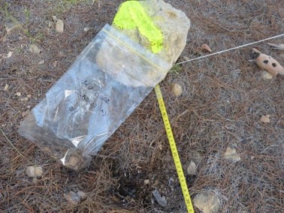
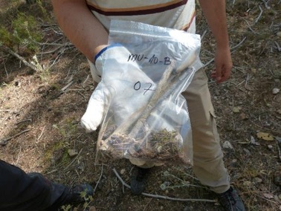
LIFE FOREST CO2 PROJECT
2.Actions
Carbon sink in fallen leaves and dead organic materials in soils modeling
Sample collection in the same places we used for soil samples.

Slide 16
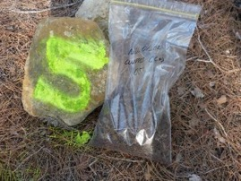
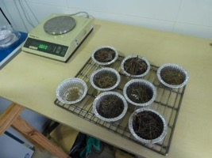
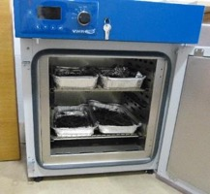
LIFE FOREST CO2 PROJECT
2.Actions
Carbon sink in fallen leaves and dead organic materials in soils modeling
Samples processing:
  Inorganic materials removal
  Drying process (60º during 24 hours, until constant weight)
  Dry weight measurement (g) and thickness (cm)

Slide 17
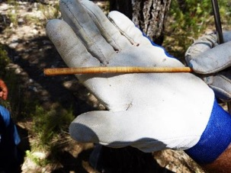
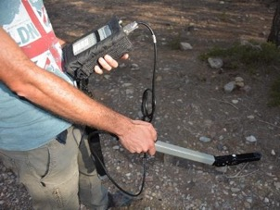
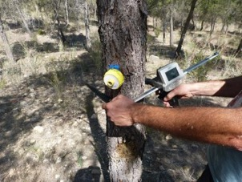
LIFE FOREST CO2 PROJECT
2.Actions
Dasometric and enviromental data collection.
Forest and enviroment data collection (amount of shade, Index Site, Density, Leaf Area index LAI) for death leaves sink models.

Slide 18
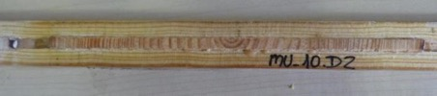
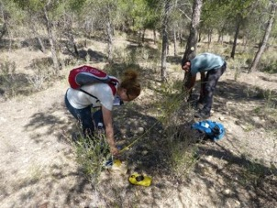
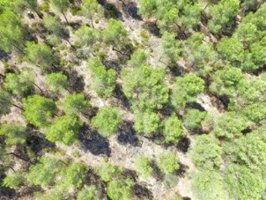
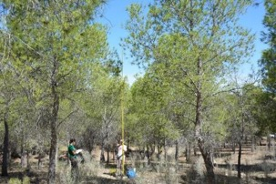
LIFE FOREST CO2 PROJECT
2.Actions
Dasometric and enviromental data collection.

Slide 19







LIFE FOREST CO2
2.Actions
Involvement of forest owners and diffuse sectors in climate change mitigation
Work with forest owners to encourage the development of sustainable forest management projects to generate CO2 credits
Work with organizations and companies from diffuse sectors to encourage carbon footprint compensations through these credits

Slide 20
LIFE FOREST CO2
2.Actions
Replication of project actions
Development of digital tools and articles to facilitate the implementation of lessons learnt in other territorial frameworks
Application of project methods with relevant social agents in chestnut tree forests (Castanea sativa) in the Macizo Central region. Application of the training lessons learnt.
Promoting the replication of actions on other forest species.
Signing cooperation agreements between national authorities and working groups to invigorate carbon sinks from Sustainable Forest Management activities.

Slide 21
LIFE FOREST CO2
2.Actions
Dissemination of results and awareness raising
Forestry research sector
Articles and publica-tions
Network-ing
Professional forestry sector
Technical meetings
Society
Dissemination materials
Lectures
Seminars
Press and Newsletters
Social networks

Slide 22

LIFE FOREST CO2
PROYECTO LIFE FOREST CO2
Introducción
3. Expected results
3.
EXPECTED RESULTS
03

Slide 23
LIFE FOREST CO2
3. Expected results
Main expected results
Accurate estimation, based on accounting rules of Decision 529/2013 / EU, of net anthropogenic absorption as a consequence of actions of Sustainable Forest Management, in Pinus halepensis and Pinus pinaster masses.
Carbon storage models, as a consequence of Sustainable Forest Management actions, will be reflected in a synthesis document. Dissemination among the main agents responsible for forest management and planning.
Increase of CO2 absorption projects with Sustainable Forest Management works within compensation initiatives at a rate of 125 after the project, achieving an estimated CO2 sequestration of 3,375 t during the project and more than 50,000 t in the long term.
Voluntary implementation of carbon footprint management measures in 200 organizations in diffuse sectors, including compensation through absorption projects, managing to reduce at least 7,000 t of CO2 emissions during the project.
Forestry should be conceived by stakeholders as an activity with high potential to generate social, economic and environmental benefits, as well as a essential tool for climate change mitigation.

Slide 24



PROYECTO LIFE FOREST CO2
3. Expected results
MAIN EXPECTED RESULTS
Precise estimation of carbón sequestration as a consequence of forest management.
Carbon sequestration models spread among Forest planners and Forest managers leaders
Development of 125 absortion projects with Forest owners
200 difuse sector organitations involved through calculation, reduction and compensation of carbon footprint.
Forests and Forestry seen as priority CC mitigation tools, generating many side benefits (ecosystem and socioeconomical).

Slide 25
LIFE FOREST CO2
3. Expected results
Ecosystem’s collateral benefits
Improving governance in LULUCF sector
Increase of forested/reforested areas
Increase of forest areas managed through sustainability standards
Improving soil protection against erosion at a local scale
Water regulation at local level
Biodiversity and natural habitats conservation
Decreased fire risk
Reduction of GHG emissions

Slide 26
LIFE FOREST CO2
3. Expected results
Socio-economic collateral benefits
Increased availability of sustainable raw materials
Direct jobs in forestry sector
Indirect jobs in services related to forestry sector (consultants, materials suppliers, etc.)
Increased investments at forestry sector
Greater protection of settlements and infrastructures linked to the forest
Reputation / image / marketing for diffuse sectors companies
Increased opportunities in markets and added value products and services of diffuse sectors companies
Increased energy efficiency, decreasing energy costs in public and private organizations

Slide 27

LIFE FOREST CO2
1. Preliminary results
4.
Achieved results

Slide 28


LIFE FOREST CO2
4. Preliminary results
Main results achieved
KNOWLEDGE IMPROVEMENT
Better knowledge of voluntary GHG emissions markets and their operation
Better knowledge of companies interested in the compensation of the carbon footprint and their concerns

Slide 29
PROYECTO LIFE FOREST CO2
4. Preliminary results
CO2FIX MODELING
We just started to writte a metodology to quantify carbon sequestration in P. pinaster y P. halepensis managed forests using free-software CO2FIX.

Slide 30
LIFE FOREST CO2
4. Preliminary results
Main achieved results
Comparison of carbon fixation, index site 24, with and without silviculture in Tn/ha over 150 years. (Left: counting bioenergy, right: without accounting for bioenergy)

Slide 31





LIFE FOREST CO2
4. Preliminary results
Main achieved results
MITIGATION INITIATIVES
25 Agreements with companies to implement mitigation measures
3 Agreement to develop a CO2 absortion forest project

Slide 32
LIFE FOREST CO2
4. Preliminary results
Some key points of LIFE FORESTCO2 Project
Involvement of private forest owners (LULUCF)
Involvement of companies in voluntary carbon compensation schemes
Definition of new business models based on the sustainable management of the forests
Enhancement of our Forests as important carbon pools in our fight against climate change
Side benefits, both ecosystem and socioeconomic, remarking vulnerability reduction of our forest formations (fire risk, plagues and diseases…)

Slide 33

THANK YOU!

Slide 34


Slide 35
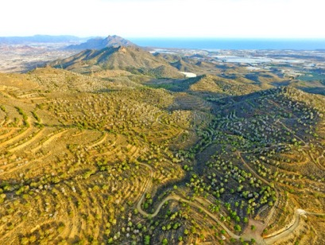
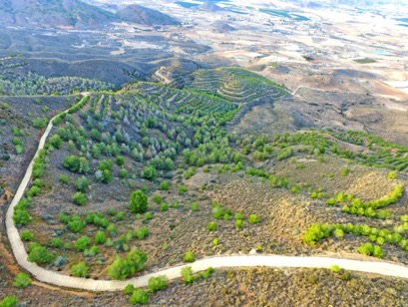
LIFE FOREST CO2
1.Introduction
Starting point
Climate change is a serious problem whose first consequences begin to manifest and therefore constitutes one of the main challenges to be faced by our society.

Slide 36





LIFE FOREST CO2
1.Introduction
TITTLE: LIFE14 CCM/ES/001271- Assessment of forest-carbon sinks and promotion of compensation systems as tools for climate change mitigation.
PROGRAMME: CLIMATE ACTION
BUDGET: 2.335.417 € (60% EU Cofinancing – 1.401.223 €)
DURATION: 02/01/2016 – 31/12/2019
PARTNERSHIP:
OISMA (REGION OF MURCIA)
AGRESTA S. COOP
FUNDACIÓN CESEFOR
CONSELLERÍA DE MEDIO AMBIENTE E ORDENACIÓN DO TERRITORIO
(XUNTA DE GALICIA)
CENTRE NATIONAL DE LA PROPRIÉTÉ FORESTIÈRE
(CNPF)
UNIVERSIDAD DE CÓRDOBA
(UCO)
INGENIERÍA DEL ENTORNO NATURAL (IDEN)

Slide 37
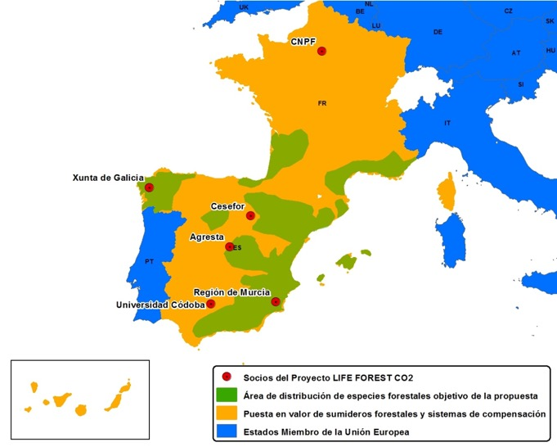
LIFE FOREST CO2
1.Introduction
Location

